Slide 1


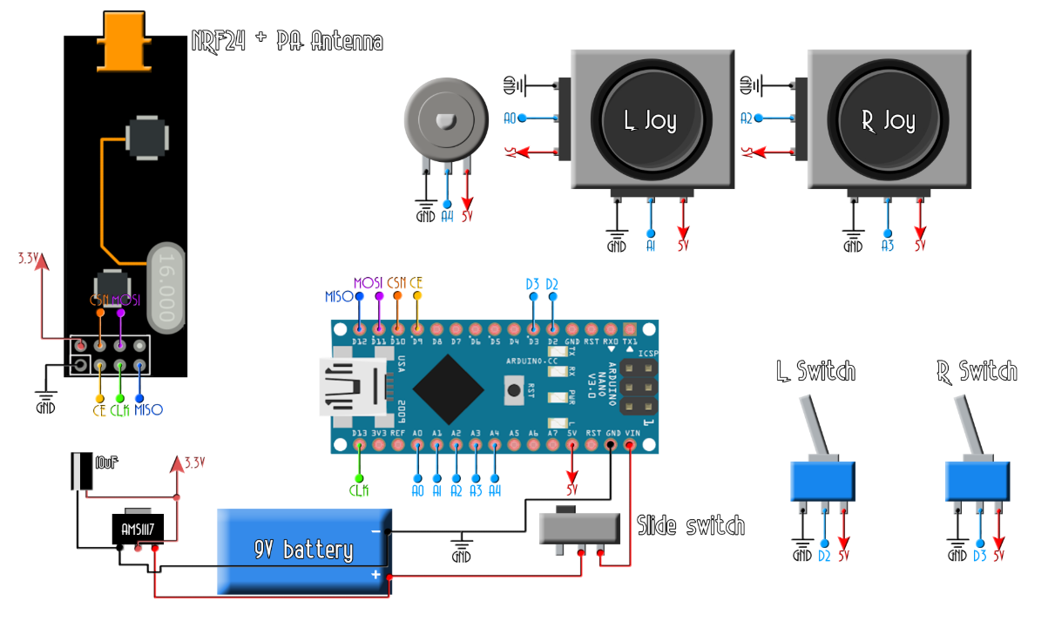
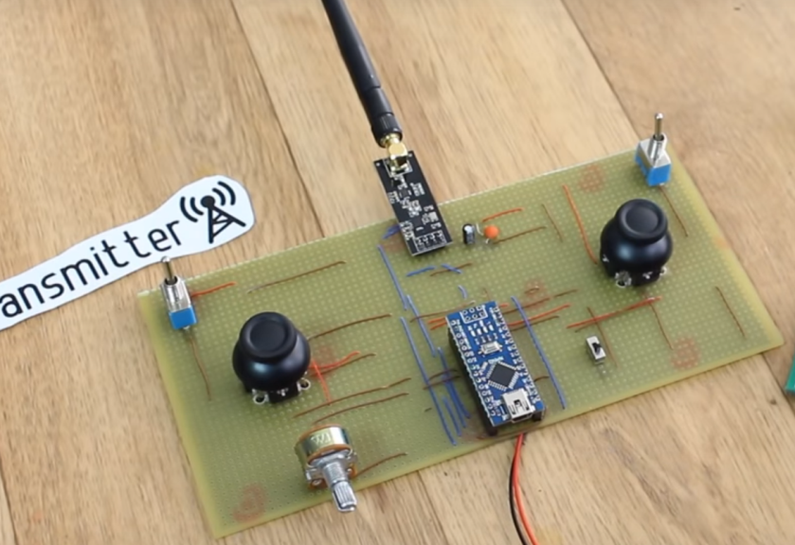
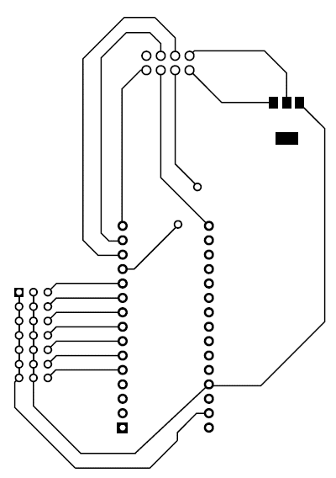
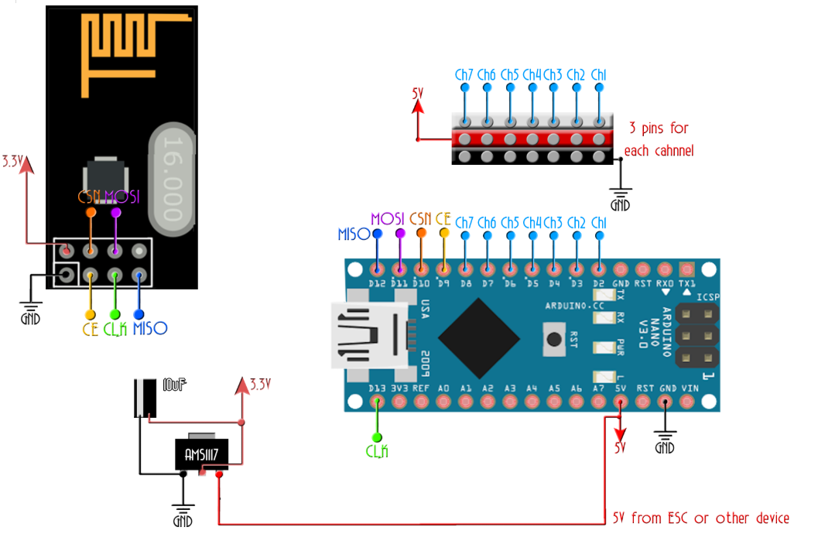
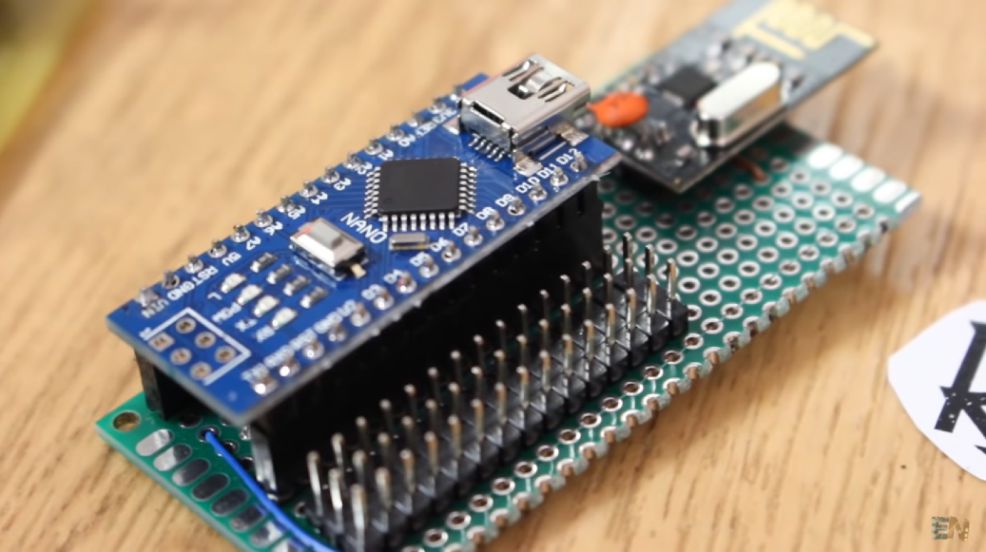
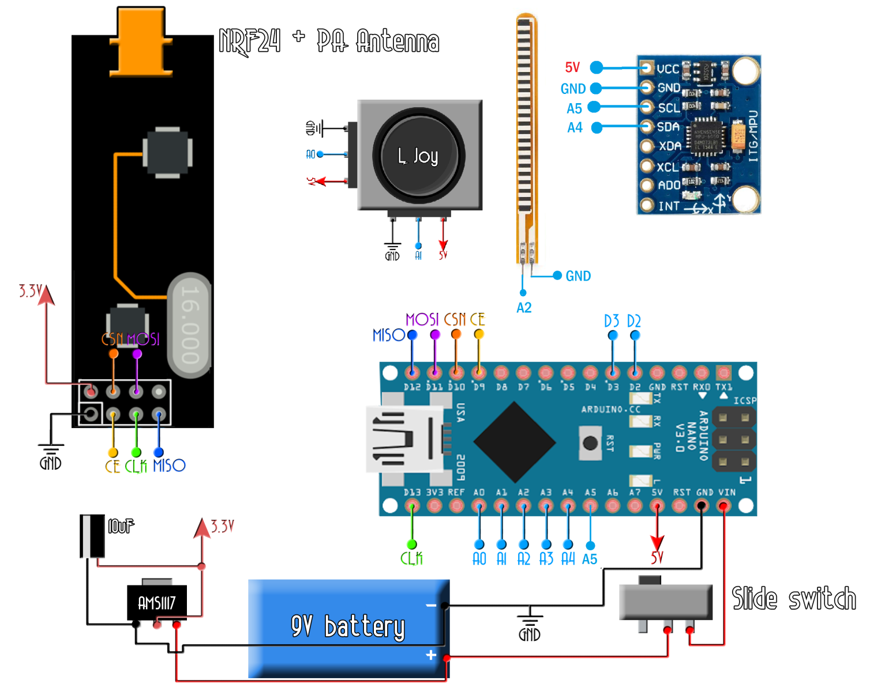
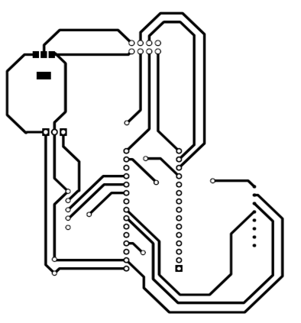
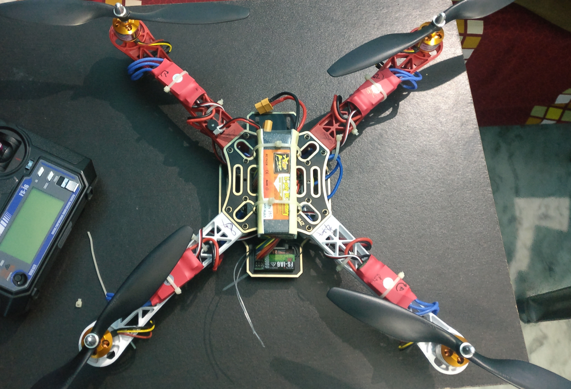
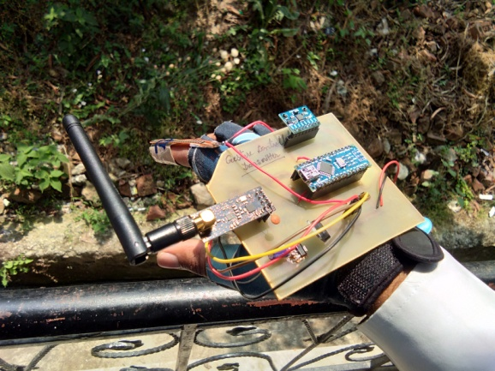
Autonomous Quad-Copter with wireless and gesture control system
B.Tech ECE (4th year)
Faiz Ahmad, C.H Madhu Kumar
Department of Electronics & Comm. Engineering, DIT University, Dehradun, India
ABSTRACT
CIRCUIT DIAGRAM
PCB DESIGNS
Mechatronics is multidisciplinary branch of engineering that focuses on the engineering of both electrical & mechanical systems, and also includes a combination of robotics, electronics, computer science, telecommunication, control and product engineering. Drones are a great example of mechatronics in practice.
Quad-copter is a device with an intense mixture of Electronics, Mechanical &mainly on the principle of Aviation. The Quad copter has 4 motors whose speed of rotation & the direction of rotation changes according to the users desire to move the device in a particular direction. The rotation of motion changes as per the transmitted signal sends from the 6-Channel transmitter. Each rotor produces both a thrust and torque about its centre of rotation.
Target 2 was to build our self made transmitter & receiver.
We used Arduino Nano and NRF module at both transmitter and receiver.
For controlling we used joysticks modules at transmitter.
Figure 3.1 : For joystick based Transmitter
Figure 2.1 : For Joystick based transmitter
Figure 1.2 : Self made transmitter based on joystick control
Figure 2.2 : For receiver
Figure 3.2 : For Receiver
PROPOSED SETUP
Figure 1.3 : Self made receiver
So we have made quad-copter & our own self-made transmitter and receiver based on palm gesture. The project is split in 3 targets.
Target 1 was to build a quad-copter and fly it on any market available transmitter & receiver.
Target 3 was to build a transmitter based on hand gesture.
MPU6050 (Gyro & Accelerometer) module was used for pitch (aleron) and roll(elivator) movement control and a flex sensor was used for throttle.
All those components were interfaced with Arduino Nano and were sent to receiver board via NRFL01 module.
Figure 3.3 : For Gesture based Transmitter
Figure 2.3 : For Gesture based transmitter
CONCLUSION
All of the components were connected according to the schematic diagram on a bread board manually and their working was checked.
Then PCB were designed on Proteus and EasyEDA .Boards were printed and etching was done to have the conduction tracks as per design.
All the components were soldered at its place on respective pin positions.
Circuits were tested via multi-meter and signals were checked on DSO.
Hence the fabrication of the quad-copter and its hand movement control has been carried out precisely. The flight testing has passed series of flight tests. After so many crashes, it is able to fly. Our goal of this project is to enable the hand gesture basic control mechanism with maximum possible accuracy. We investigated on software development for this project.
REFERENCES
Peter Dalmaris at https://www.udemy.com/
https://howtomechatronics.com
Eduvance training
Figure 1.1 : The complete built quad-copter
Figure 1.4 : Self made transmitter based on gesture control

